Slide 1
Chapter 2:
The Database Development Process
IST659 Week 1

Slide 2
Announcements
Assigned today:
  Project Ideas
  Due on Blackboard Discussion Board before Week 3

Slide 3
Objectives
Define more terms
Describe the system development life cycle
Explain the prototyping approach
Explain the roles of individuals in the system
Explain the three-schema approach
Explain the role of packaged data models
Explain three-tiered architecture
Draw simple data models

Slide 4
Information Systems Architecture
Conceptual blueprint for organization’s desired information systems structure
Consists of:
  Data (e.g. Enterprise Data Model – simplified ER Diagram)
  Processes – data flow diagrams, process decomposition, etc.
  Data Network – topology diagram
  People – people management using project management tools (Gantt charts, etc.)
  Events and points in time (when processes are performed)
  Reasons for events and rules (e.g. decision tables)

Slide 5
SDLC Strategies
A data-oriented methodology to create and maintain information systems
Top-down Strategy: a planning approach for obtaining a broad understanding of the data needs across the entire organization
Bottom-up Strategy: a planning approach for obtaining the data needs from the end user’s perspective
Hybrid Strategy: a planning approach that bridges both strategies by getting overall data needs and specific end user data needs

Slide 6
INFORMATION SYSTEMS PLANNING

Slide 7
Information Systems Planning
Why do we do information systems planning?
We want to align information technology with organization’s business strategies (strategic goals)
Three steps:
    Identify strategic planning factors
    Identify corporate planning objects
    Develop enterprise model

Slide 8
Identify Strategic Planning Factors
Organization goals – what we hope to accomplish
Critical success factors – what MUST work for us to survive
Problem areas – weaknesses we now have

Slide 9
Identify Corporate Planning Objects
Organizational units – departments
Organizational locations
Business functions – groups of business processes
Entity types – the things we are trying to model for the database
Information systems – application programs

Slide 10
Develop Enterprise Model
Models for planning:
  Enterprise data model
  Functional decomposition
  Planning matrixes

Slide 11
Enterprise Data Model
First step in database development is to develop/review your enterprise model
Specifies scope and general content
Overall picture of organizational data at high level of abstraction
Entity-relationship diagram
Descriptions of entity types
Relationships between entities
Business rules

Slide 12
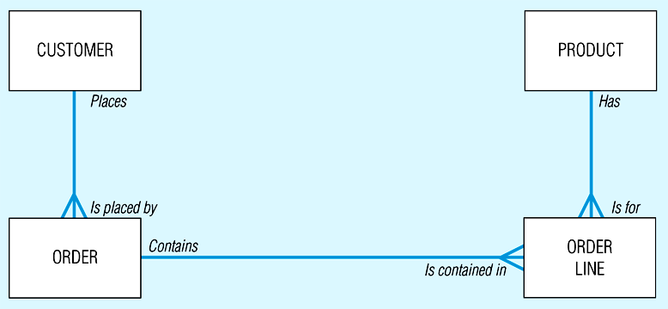
Segment from enterprise data model
Enterprise data model describes the high-level entities in an organization and the relationship between these entities

Slide 13
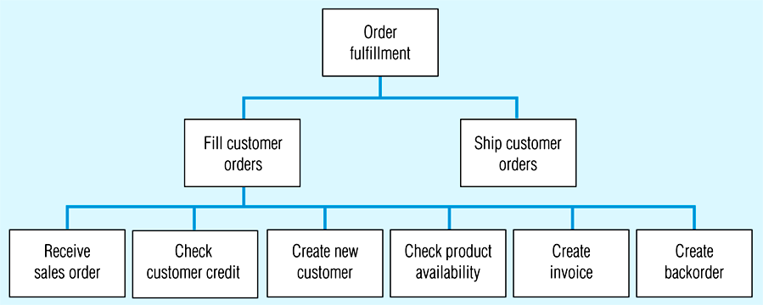
Functional decomposition - order fulfillment process
Decomposition -- breaking large tasks into smaller tasks in a hierarchical structure chart

Slide 14
Functional decomposition - order fulfillment process

Slide 15
Functional decomposition - order fulfillment process

Slide 16
Planning Matrixes
Describe relationships between planning objects in the organization
Types of matrixes:
  Function-to-data entity
  Location-to-function
  Unit-to-function
  IS-to-data entity
  Supporting function-to-data entity
  IS-to-business objective

Slide 17
Example team to location planning matrix
Syracuse
New York
Charlotte
Jersey City
Location
Business Team
Business Planning X
Product Development X X
Materials Management X X X
Order Fulfillment X X X X
Finance and Accounting X X X X

Slide 18
Elaborate planning matrix
(Data Entity Type to Business Function)
Customer
Product
Raw Material
Order
Work Center
Work Order
Invoice
Equipment
Employee
Data Entity
Types
Business
Function (users)
Business Planning X X X X
Product Development X X X X
Materials Management X X X X X X
Order Fulfillment X X X X X X X X X
Order Shipment X X X X X X
Sales Summarization X X X X X
Production Operations X X X X X X X
Finance and Accounting X X X X X X X X

Slide 19
Two Common Approaches to Database Development
SDLC (Waterfall)
  System Development Life Cycle
  Developed by Winston Royce circa 1970
  Detailed, well-planned development process
  Time-consuming, but comprehensive
  Long development cycle
Prototyping (Agile)
  Rapid application development (RAD)
  Cursory attempt at conceptual data modeling
  Define database during development of initial prototype
  Repeat implementation and maintenance activities with new prototype versions

Slide 20
Systems Development Life Cycle
Systems Development Life Cycle
I combine these into a Planning Phase
I combine these into a Planning Phase
Project Identification
and Selection
Project Identification
and Selection
Project Initiation
and Planning
Project Initiation
and Planning
Analysis
Analysis
Logical Design
Logical Design
Physical Design
Physical Design
And these into a Design Phase
And these into a Design Phase
Implementation
Implementation
Maintenance
Maintenance

Slide 21
Systems Development Life Cycle (Conti.)
Project Identification
and Selection
Purpose - preliminary understanding
Deliverable – request for project
Project Identification
and Selection
Project Initiation
and Planning
Project Initiation
and Planning
Analysis
Analysis
Logical Design
Logical Design
Physical Design
Physical Design
Database activity –
enterprise modeling
Implementation
Implementation
Maintenance
Maintenance

Slide 22
Systems Development Life Cycle (Conti.)
Project Identification
and Selection
Purpose – state business situation and solution
Deliverable – request for analysis
Project Initiation
and Planning
Analysis
Logical Design
Physical Design
Database activity –
conceptual data modeling
Implementation
Maintenance

Slide 23
Systems Development Life Cycle (Conti.)
Project Identification
and Selection
Purpose – thorough analysis
Deliverable – functional system specifications
Project Initiation
and Planning
Analysis
Logical Design
Physical Design
Database activity –
conceptual data modeling
Implementation
Maintenance

Slide 24
Systems Development Life Cycle (Conti.)
Project Identification
and Selection
Purpose – information requirements structure
Deliverable – detailed design specifications
Project Initiation
and Planning
Analysis
Logical Design
Physical Design
Database activity –
logical database design
Implementation
Maintenance

Slide 25
Systems Development Life Cycle (Conti.)
Purpose – develop technology specs
Deliverable – program/data structures, technology purchases, organization redesigns
Project Identification
and Selection
Project Initiation
and Planning
Analysis
Logical Design
Physical Design
Database activity –
physical database design
Implementation
Maintenance

Slide 26
Systems Development Life Cycle (Conti.)
Purpose – programming, testing, training, installation, documenting
Deliverable – operational programs, documentation, training materials
Project Identification
and Selection
Project Initiation
and Planning
Analysis
Logical Design
Database activity –
database implementation
Physical Design
Implementation
Maintenance

Slide 27
Systems Development Life Cycle (cont.)
Project Identification
and Selection
Purpose – monitor, repair, enhance
Deliverable – periodic audits
Project Initiation
and Planning
Analysis
Logical Design
Database activity –
database maintenance … longest and most expense phase of any project
Physical Design
Implementation
Maintenance

Slide 28
Agile Software Development Methodologies
Extreme Programming
Scrum
Kanban
Prototyping

Slide 29
AGILE
(Scrum)

Slide 30
What is Scrum Methodology?
Iterations – Sprints
  Sprint is a time-box that typically last 2-4 weeks.
Board
Ceremonies
  Backlog Grooming
  Sprint Planning
  Sprint Review
  …
Roles
  Product Owner
  Team
  Scrum Master
  Coach (sometimes)

Slide 31
AGILE
(Prototyping)

Slide 32
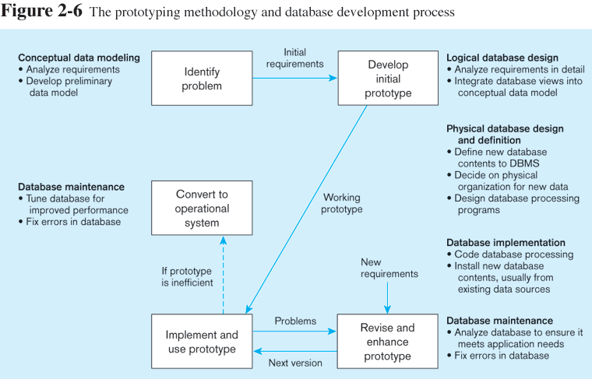

Slide 37
Agile Methodology vs Waterfall Methodology
What is the change in mindset?
How are they different?
Why does one work better than another?
What are organizations currently doing?

Slide 38
MANAGING PROJECTS

Slide 39
Managing Projects
Project - A planned undertaking of related activities to reach an objective that has a beginning and an end
Involves use of review points (deliverables / check points) for:
  Validation of satisfactory progress
  Step back from detail to overall view
  Renew commitment of stakeholders
Incremental commitment – review of systems development project after each development phase with re-justification after each phase.

Slide 40
Managing Projects: People Involved
Systems analysts
Data analysts
Users
Programmers or Application developers
Database administrators
Systems programmers, network administrators, testers, technical writers

Slide 41
CASE
Computer-Aided Software Engineering (CASE) – software tools providing automated support for systems development
Three database features:
  Data modeling – entity-relationship diagrams
  Code generation – SQL code for table creation
  Repositories – knowledge base of enterprise information

Slide 42
THREE-SCHEMA APPROACH

Slide 43
What is the three-schema approach?
The three-schema approach in software engineering is an approach to building information systems.
It originated in the 1970’s
The approach was defined by the ANSI/SPARC committee
https://en.wikipedia.org/wiki/Three_schema_approach

Slide 44
Database Schema
Conceptual Schema
E-R models
Internal Schemas
Logical Schema
Physical Schema
  Physical structures
External Schema
User Views
Subsets of Conceptual Schema
Can be determined from business-function/data entity matrices
DBA determines schema for different users

Slide 45
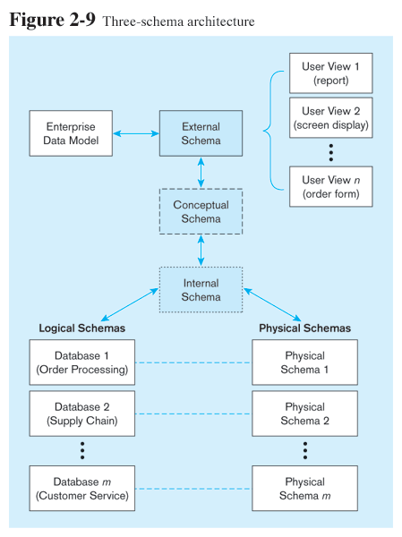
Different people have different views of the database…these are the external schema
The internal schema is the underlying design and implementation

Slide 46
THREE TIER ARCHITECTURE

Slide 47
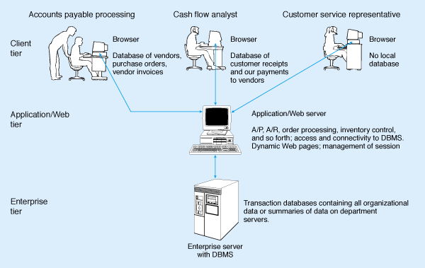
Three-tiered client/server database architecture

Slide 48
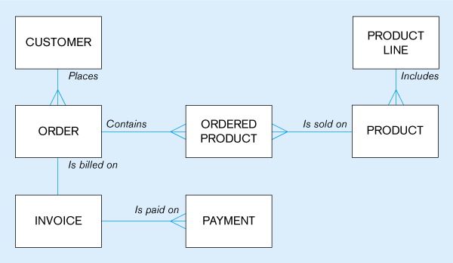
Data Model for Pine Valley Furniture example used throughout our textbook
Example of a data model
Using Crow’s Foot notation … notice the crow’s feet

